Slide 1
Question and Answering capabilities of LLMs
Ayush Gupta
Date 22/03/2024

Slide 2
Overview
Motivation
Experiment 1
Observations from experiment 1
Experiment 2
Inferences from experiment 2
Conclusions

Slide 3
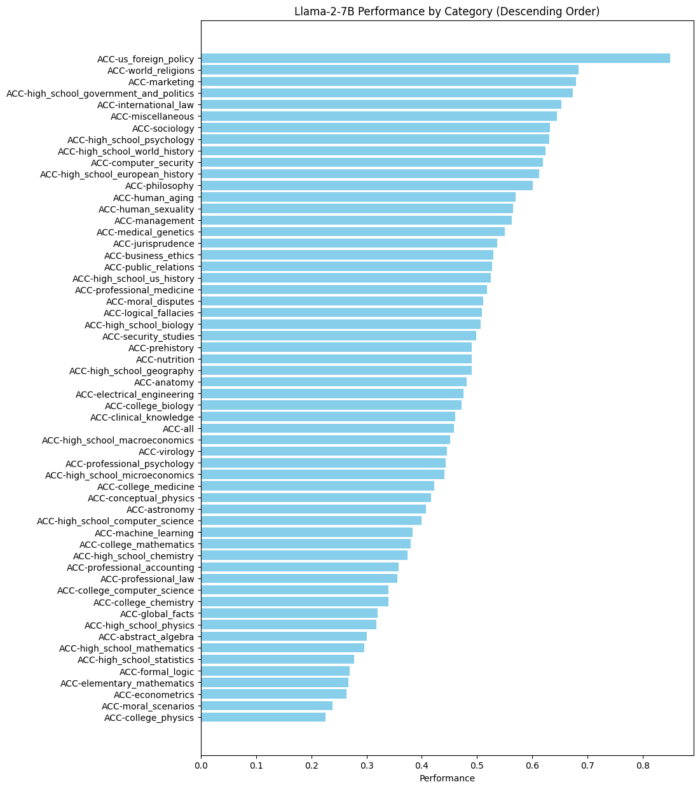
Motivation
Introduction of LLMs have taken the world by a storm.
LLM’s have good breadth of knowledge, but how do they perform on new knowledge?
MMLU -> Massive Multitask Language Understanding.
Measure knowledge of pretrained models
57 subjects including STEM, History, Politics, etc.
Most used benchmark.
Benchmarking LLMs reliably is a very hot topic currently, with no concrete set of metrics.
MMLU score and performance of llama2

Slide 4
Experiments
Main Goals
In this presentation we explore the Q&A abilities of open-source Large Language Models.
We look at their performance with and without relevant context.
Measure their performance through traditional NLP practices.
Find alternative methods to the above NLP methods.
Experiments:
1. Measuring n-gram based NLP metrics for an LLM.
2. Measuring Q&A capabilities of LLM when given a specific context on which it hasn’t been trained via RAG.

Slide 5
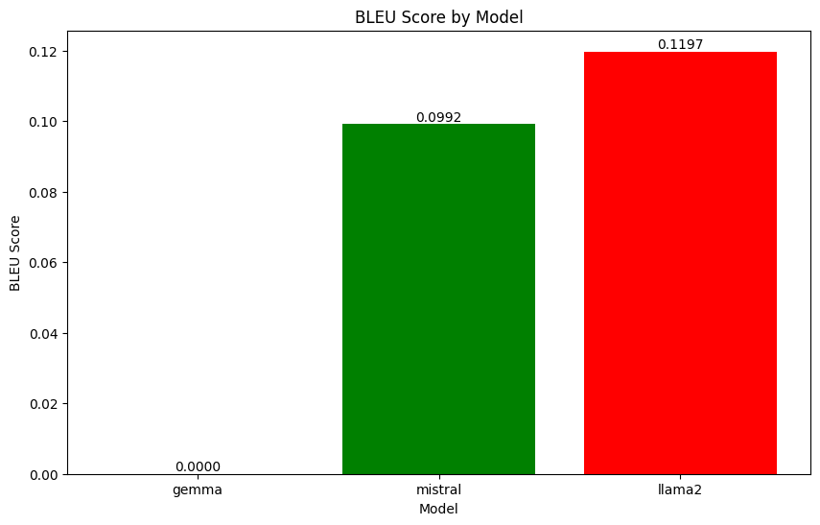
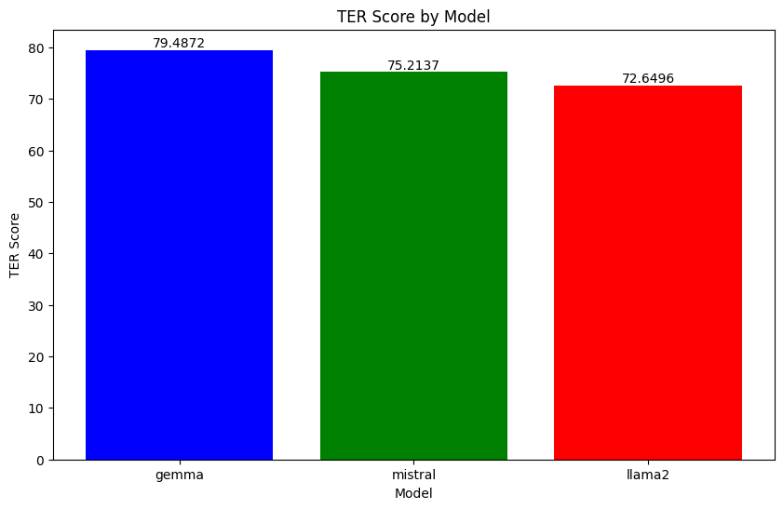
Experiment 1: n-gram based tests
Setting up the Experiment:
Prompt the LLMs with a specific question.
Have a reference answer text against which the LLM’s responses will be tested.
Question -> Tell me about the Battle of Boyne in 100 words.
BLEU, ROUGE and TER scores are calculated
BLEU -> quality of machine translated text based on overlap of n-gram phrases.
ROUGE -> evaluating machine translation using overlap of n-grams, word sequences, and word pairs b/w reference and response.
TER -> amount of editing required to a machine translation to match reference text.
The performance is quite poor.
Performance on NLP metrics

Slide 6
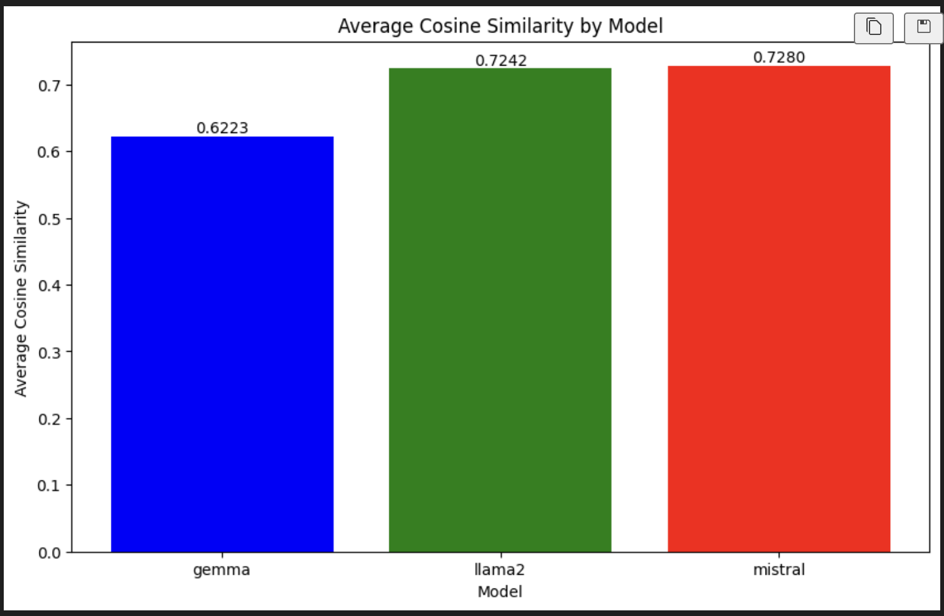
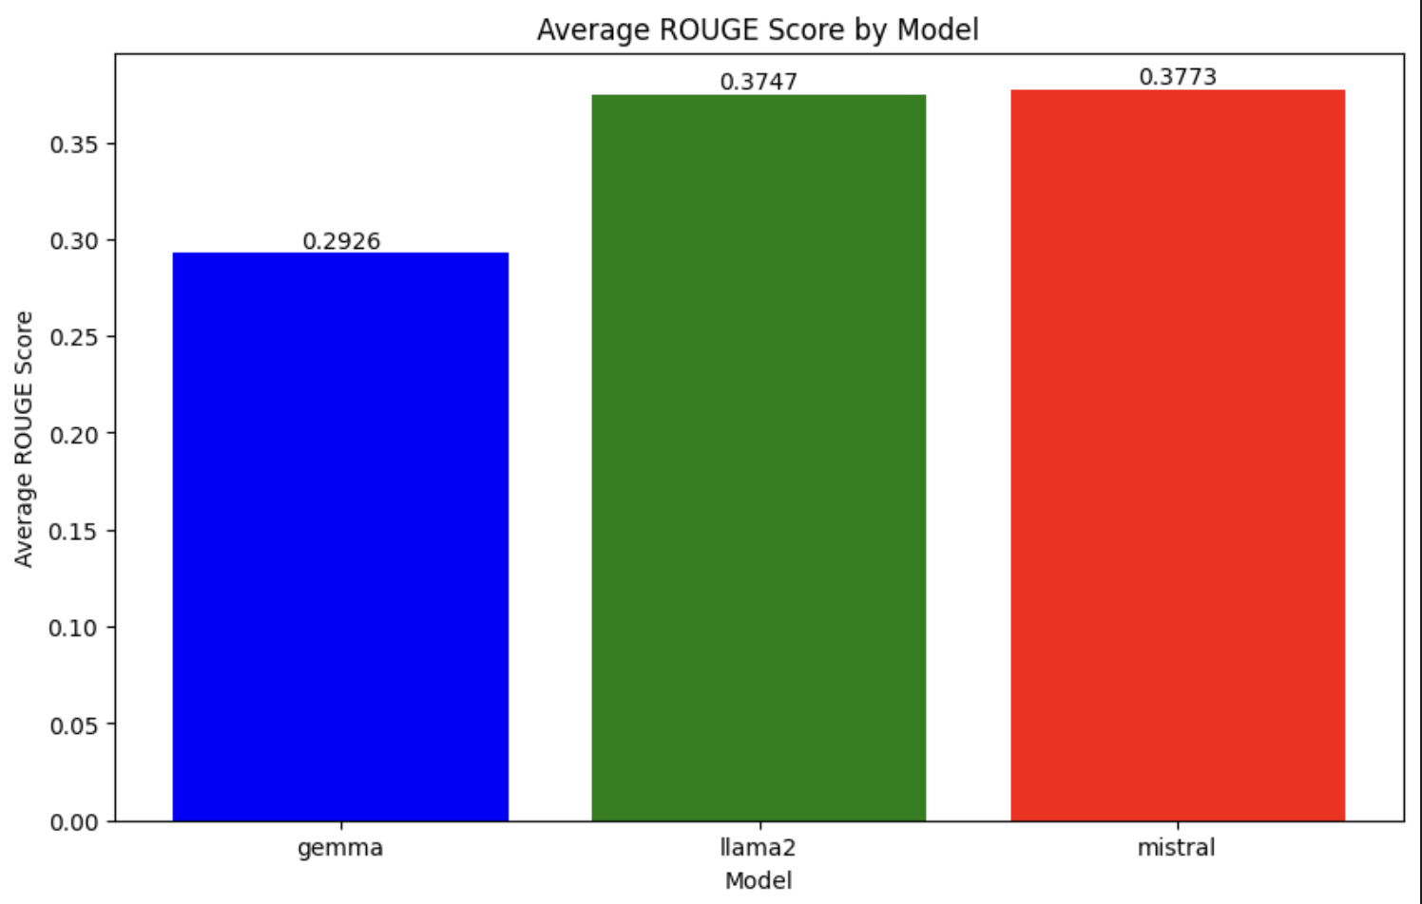
N –Gram based Testing
Observations:
BLEU scores are very low -> expected since summarization tasks generally perform poorly.
ROUGE score indicates higher overlap with reference text’s n-grams.
TER score is high across the board, indicating poor performance. Again, expected due to summarization nature and metric is used for translation.
Cosine similarity is relatively high which indicates good semantic alignment.

Slide 7
Experiment 2: Introduction of RAG
RAG -> retrieves relevant information from corpus
How it works:
Input query is converted into an embedding(high dimensional vector); easier to work with vectors
Above query is used to search for pre-processed queries.
Retrieved query is used to provide context for generating response.
Movies released in 2023 are taken as RAG stores
Barbie
Oppenheimer

Slide 8
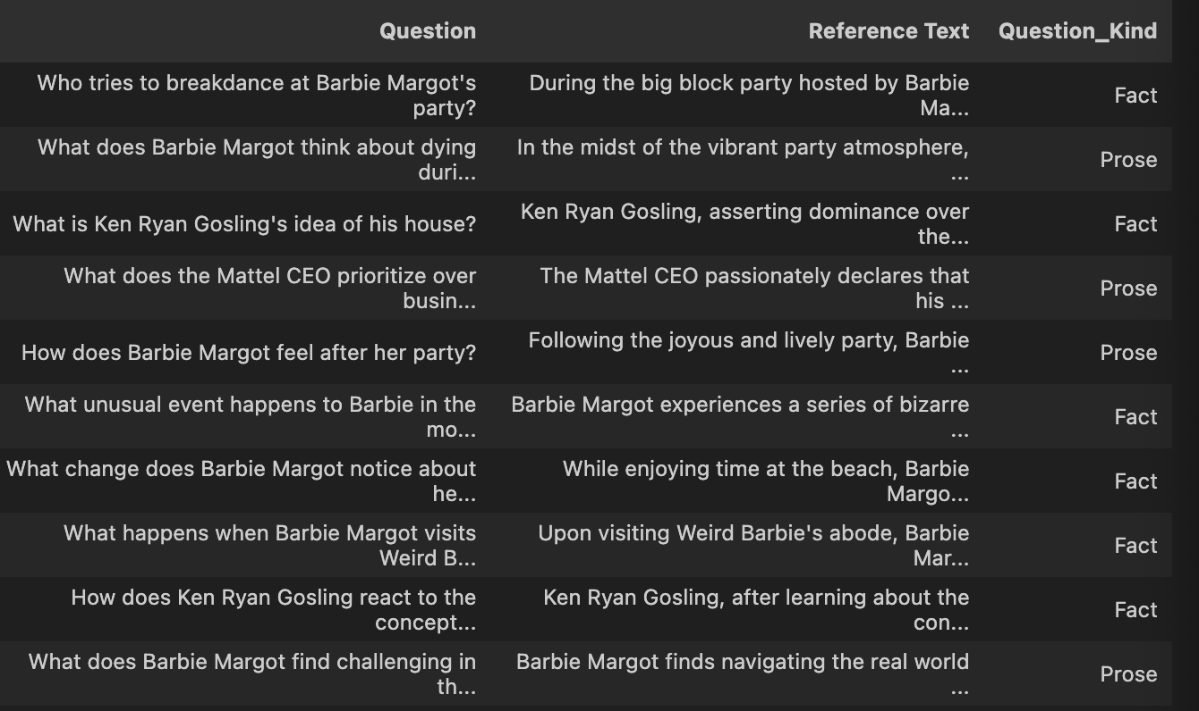
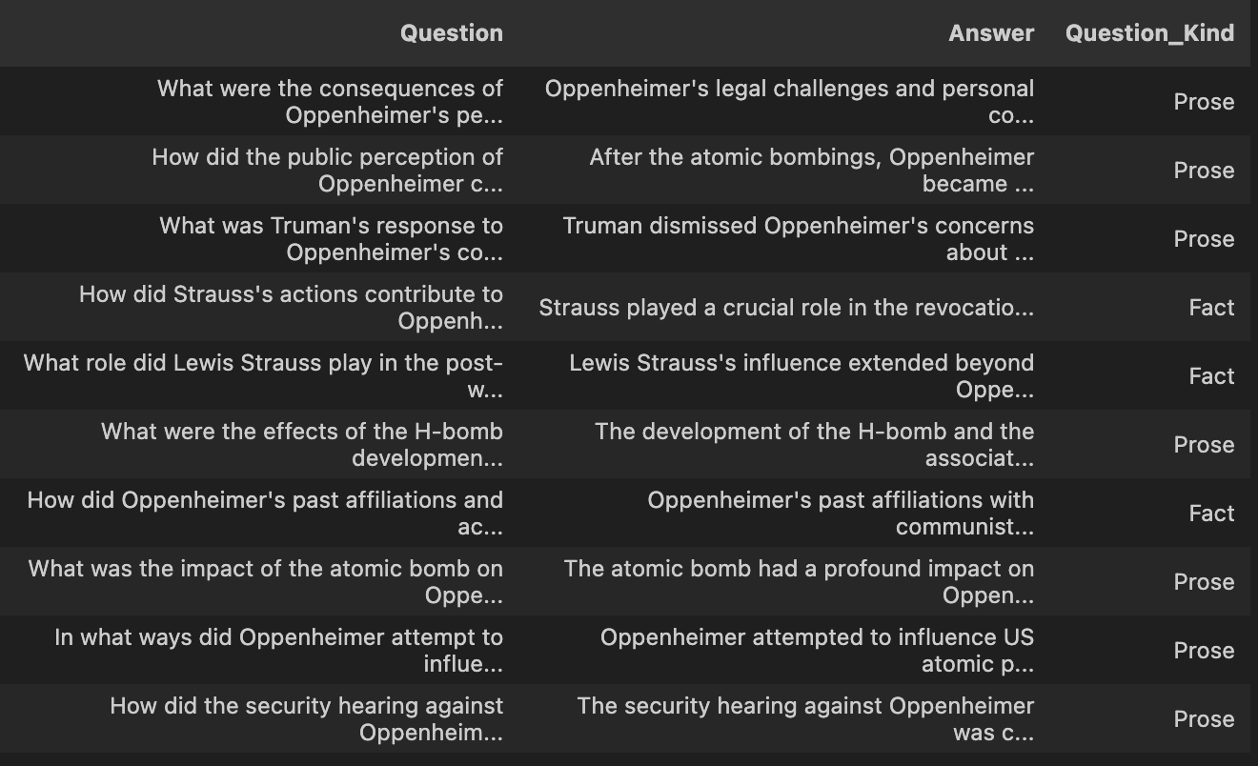
Tests Performed
We perform the following test:
BERTScore -> uses BERT’s contextual embeddings to compute similarity between words in reference and generated text via cosine similarity.
Semantic search -> uses meaning and context to find the most relevant information.
Testing methodology:
10 questions each are formed about the movie along with corresponding reference answers.
Questions are categorise based on knowledge/ prose.
LLM’s responses are tested against the reference text, before and after giving access to context and RAG.
Reference Barbie Question set
Reference Oppenheimer Question set

Slide 9
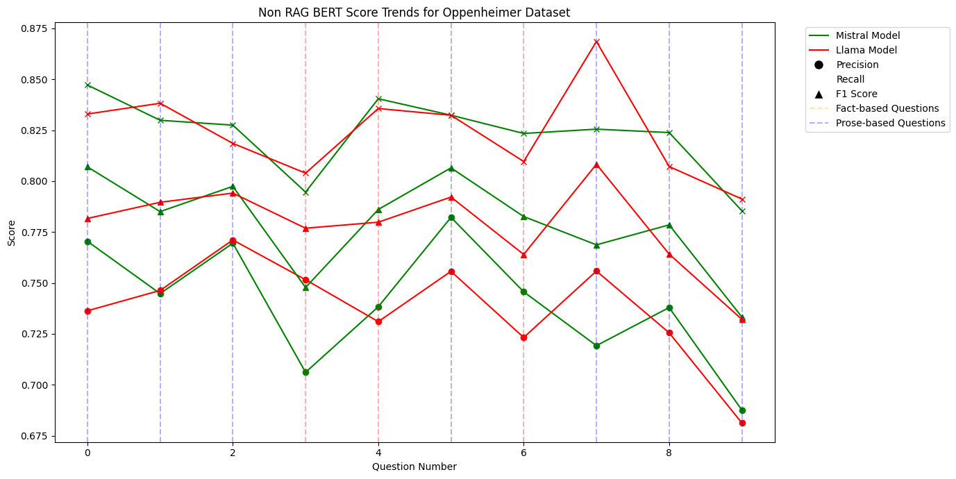
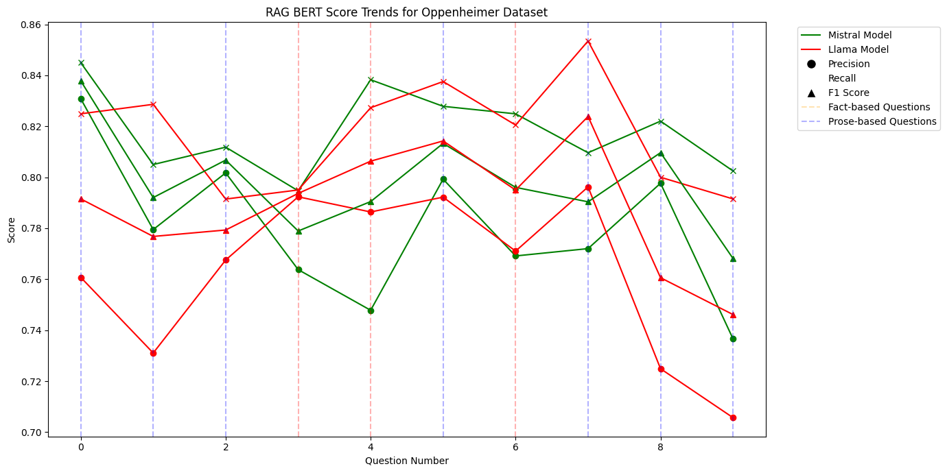
No RAG v/s RAG Performance (Oppenheimer)
• Noticeable fluctuation -> inconsistent performance
• Performance is good could be since Oppenheimer is very famous naturally and has good amount of information on him already.
• Less variance is observed in the scores, suggesting a stabilized baseline performance after RAG especially in Mistral.
• Similar trends are observed, and performance is affected by the question kind.

Slide 10
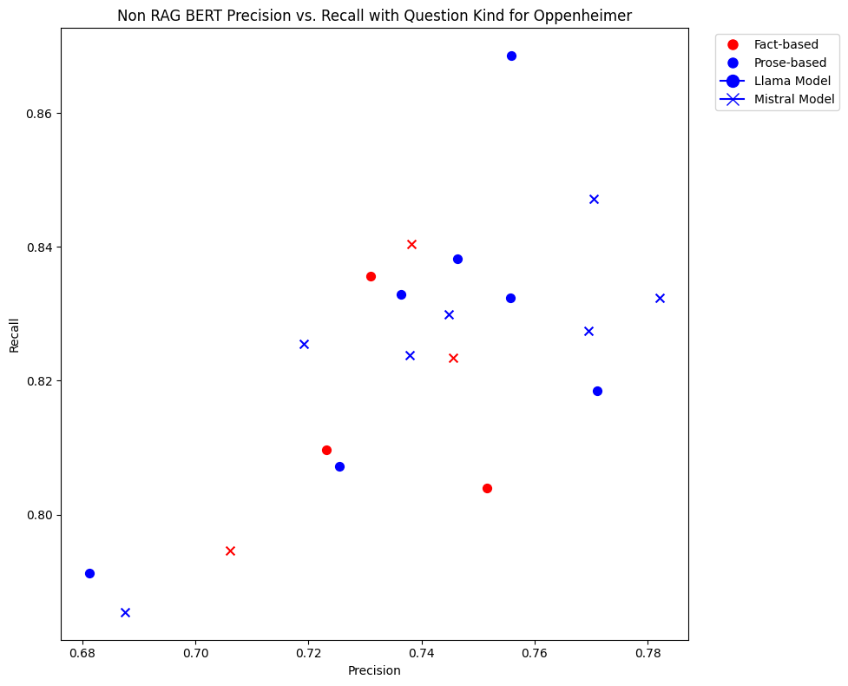
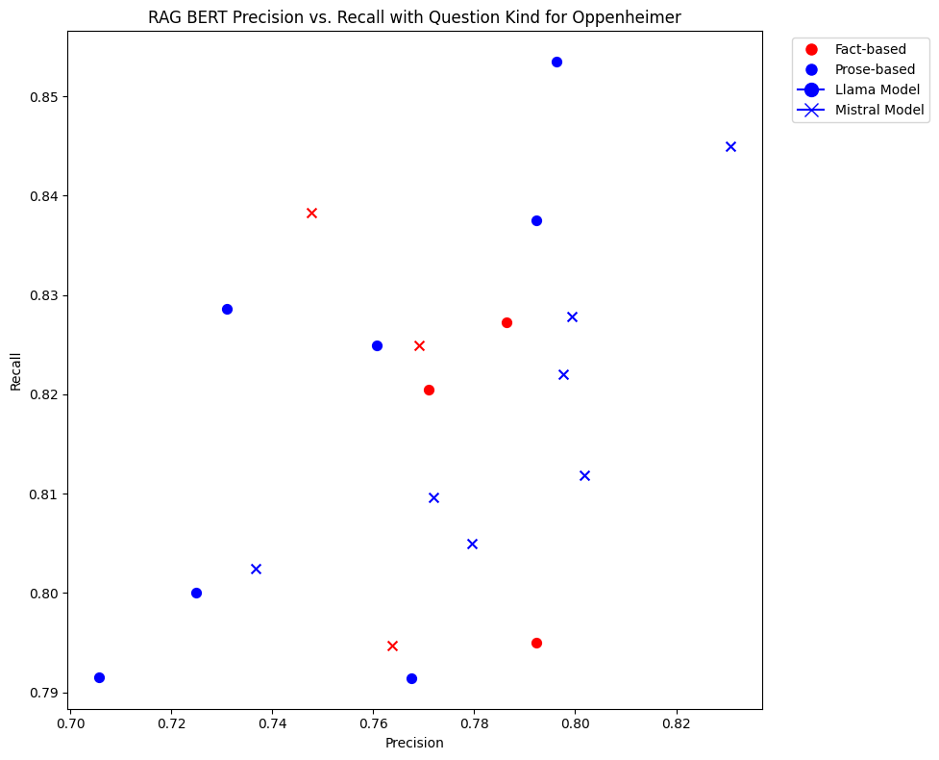
Precision vs recall (Oppenheimer)
• Prose based questions see lower performance due to translational complexity.
• Question asked as facts, are related to events in the movie and hence low precision and recall are observed.
• the variance in recall and precision for both the models is relatively the same
• a slight increase in precision is observed after adding the RAG context
• still, small changes are observed due to the nature of the questions being asked and Oppenheimer being quite famous and having material on him already.

Slide 11
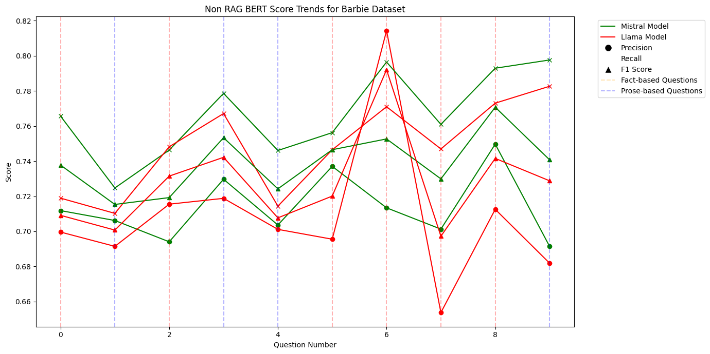
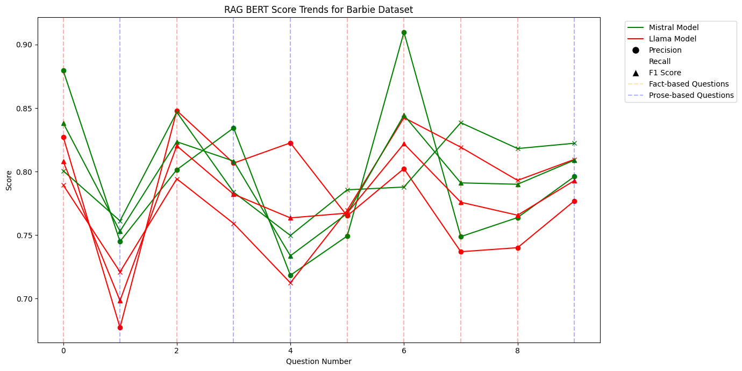
No RAG v/s RAG Performance (Barbie)
• Lower scores for precision and recall observed when compared to Oppenheimer
• expected since the movie is fictional and is not included in prior training data.
• still a decent performance in terms of not having seen the context.
• As observed earlier, the variance is notably low in RAG scores
• some higher peaks are observed in precision, generally, higher scores are observed in fact-based questions (red dotted vertical)
• similar but improved scores are observed in prose based Questions.

Slide 12
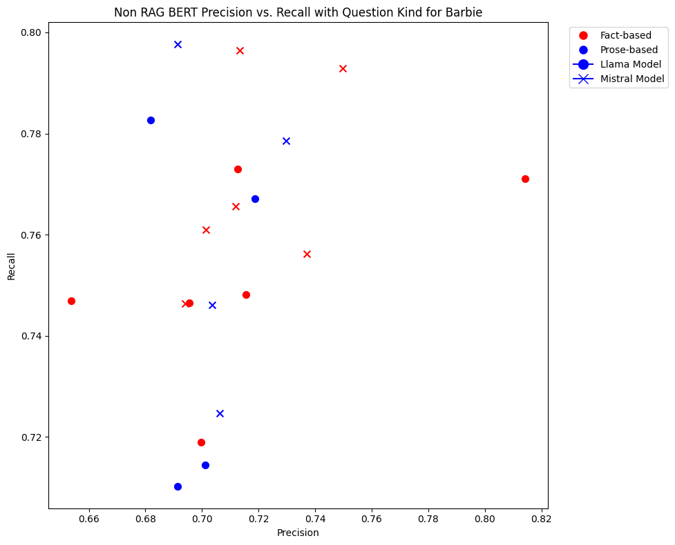
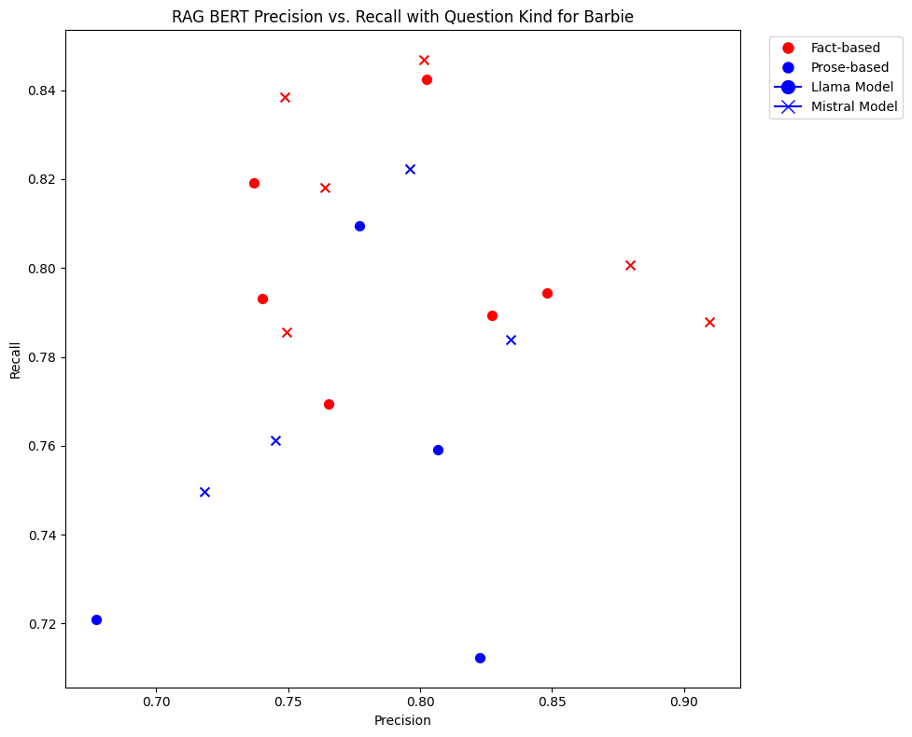
Precision vs recall (Barbie)
• Low precision scores are observed across the board due to fictional nature of the movie.
• for some questions, high precision and recall can be observed.
• High variance in precision is observed in fact-based question, again, expected due to fictitious nature of the movie and being out of context.
• Higher precision and recall scores are observed indicating RAG stabilizing the performance on questions.
• After RAG, Precision and Recall has improved relatively significantly across the board.
• lower variance in fact based questions is also observed.

Slide 13
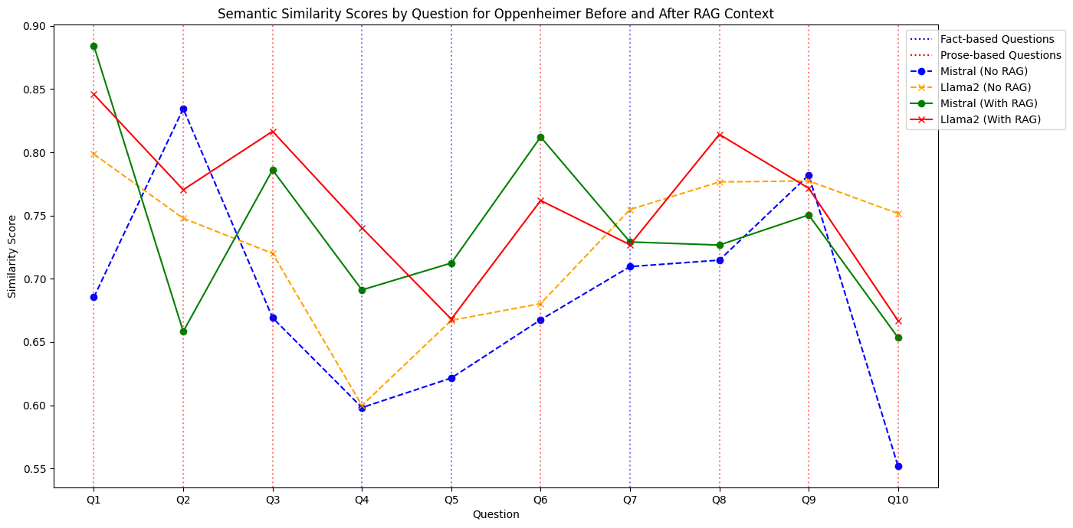
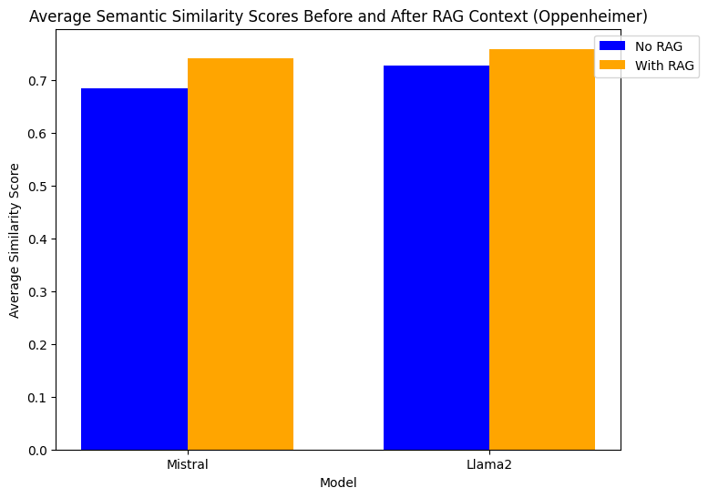
Semantic Similarity(Oppenheimer)
• Better performance is observed in semantic similarity after providing the RAG context.
• Scores are still erratic but after providing the context, both the models are more similar than they are dissimilar(except Q2,Q8).
• Only small increase in semantic similarity is observed.

Slide 14
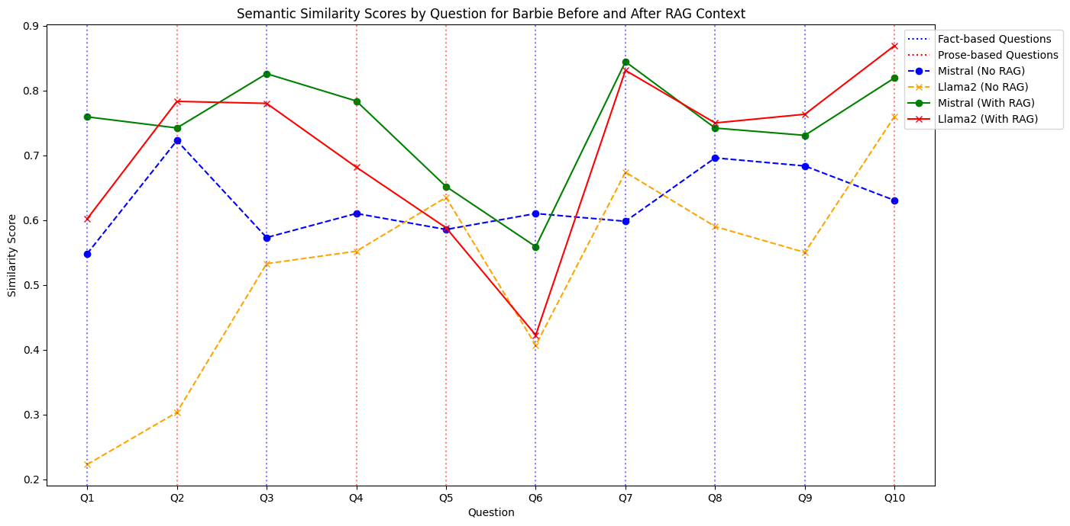
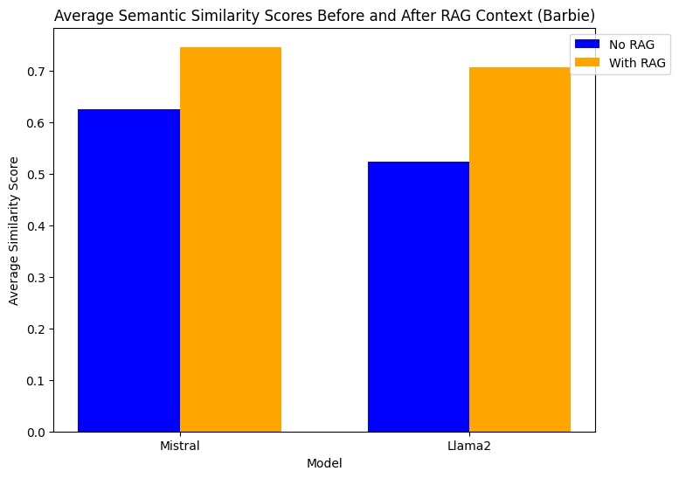
Semantic Similarity(continued)
• After RAG, both models are very similar in performance, more tightly coupled.
• significant increase in semantic similarity is observed across the board, especially in fact-based questions.
• Prose based questions still perform relatively the same.

Slide 15
Inference from Experiment 2
Performance is based on the kind of question being asked, poor performance on prose-kind questions observed before and after RAG.
Relative improvement in scores observed in Fact-based questions after the introduction of the RAG.
Q&A on Fictional movie (barbie) observed more improved performance when compared to Non-fictional movie based on a famous historical character(Oppenheimer).

Slide 16
Conclusions
• Traditional NLP doesn’t capture the performance and performance improvement in LLMs very well.
• Alternative methods of assessment such as semantic search and BERTScore can capture the nuances of LLMs more efficiently.
• Fact based questions see significant improvement when an RAG(context) is fed into the system.
• Improvement in Q&A capabilities on fictitious material observed to be higher than non-fictitious material.

Slide 17
Questions ?

Slide 18
Thank You

